Slide 1
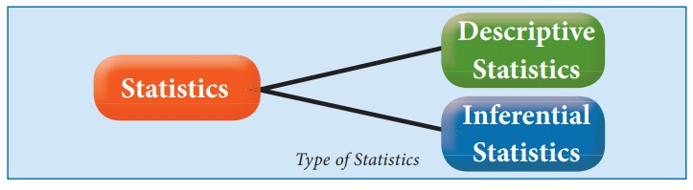
Statistic for Machine Learning
Descriptive Statistics (Mean, Median, Mode, Variance, Standard Deviation)
What is statistic, Types of Statistic, Role in machine learning

Slide 2
Descriptive Statistics (Mean, Median, Mode, Variance, Standard Deviation)
Probability Basics (Conditional Probability, Bayes’ Theorem)
Distributions (Normal, Binomial, Poisson)
Hypothesis Testing (p-values, t-test, Chi-square test)
Correlation and Covariance
Sampling and Central Limit Theorem

Slide 3
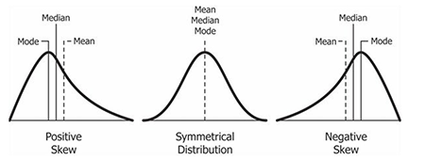
What is statistic
Statistics is a branch of mathematics that deals with collecting, analyzing, interpreting, and presenting data. It helps in finding patterns, making predictions, and making informed decisions based on data.
answer questions like:
What is the average height of students in a school?
How spread out are exam scores in a class?
If we observe past trends, can we predict future sales of a product?

Slide 4
Role In Machine Learning
1. Data Understanding & Preprocessing
Mean, Median, Mode → To understand central tendencies.
Standard Deviation, Variance → To measure data spread.
Outlier Detection → Identifying anomalies using Z-score or IQR.
2. Feature Selection & Engineering
Correlation & Covariance → Identify relationships between features.
Chi-Square Test & ANOVA → Check if a feature significantly impacts the target variable.
3. Probability & Decision Making
Bayesian Networks → Based on conditional probability.
Naïve Bayes Classifier → Assumes independence between features.
Markov Chains → Used in sequential predictions like weather forecasting.
4. Model Evaluation & Validation
Accuracy, Precision, Recall, F1-score → Measure model correctness.
Confusion Matrix → Analyzes classification errors.
R² Score & RMSE (Root Mean Squared Error) → Evaluate regression models.

Slide 5
Types of statistic
Age | Gender | Label
30 | Male | Yes
20 | Male | no
Prediction
model
Descriptive Statistics – This type summarizes and describes the main features of a dataset. It includes measures like mean, median, mode, standard deviation, variance, and visual tools such as histograms and box plots.
Inferential Statistics – This type makes predictions or inferences about a larger population based on a sample. It involves hypothesis testing, confidence intervals, regression analysis, and probability distributions to draw conclusions beyond the observed data.

